Slide 1

Kelmarsh Windfarm
Energy Audit and Analytics
A Lighthouse Labs Data Science
Capstone Project
Nico SAN PEDRO

Slide 2
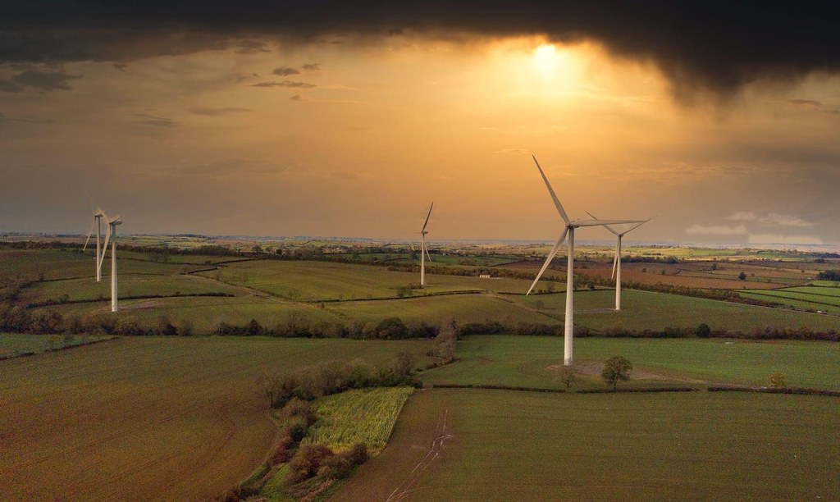
Contents
Introduction to Wind Turbines
Energy Audit
Energy Analytics
Recommendations
Image source: Paul Yates

Slide 3
1.0 Introduction
Wind Turbines

Slide 4
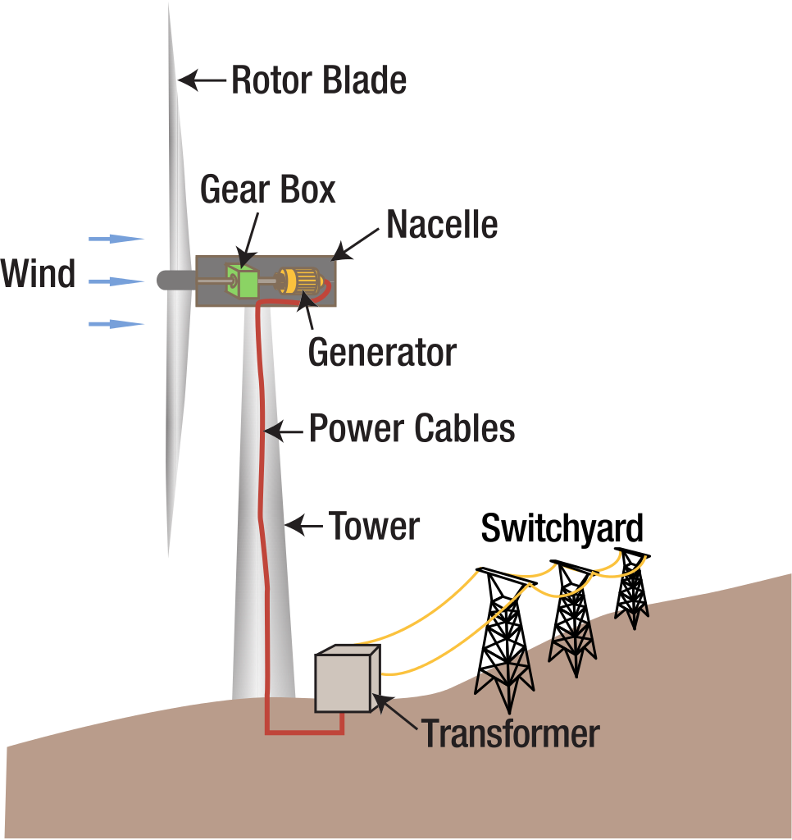
1.1 What is a turbine
Image source
Introduction

Slide 5
1.1 What is a turbine
Image source
Introduction

Slide 6
1.1 What is a turbine
Image source
Introduction

Slide 7
1.1 What is a turbine
Image source
Introduction

Slide 8
1.1 What is a turbine
Image source
Introduction

Slide 9
1.1 What is a turbine
Image source
Introduction

Slide 10
Windfarm Site Performance
Average Wind Speed and Wind Density
(Annual)
Energy Audit

Slide 11
1.2 Data Source and Project Limitations
Windfarm Information and Data Source:
Company: Blue Energy
Windfarm Location: Kelmarsh, England
Wind Turbines Number: 6 Turbines
Data Source: Public Open Dataset
Image source: Paul Yates
Introduction

Slide 12
1.2 Data Source and Project Limitations
Dataset Details:
- Recorded data from SCADA system
- CSV format
- One CSV file for each turbines
- About 5.0 GB worth of data
Image source: Paul Yates
Introduction

Slide 13
1.2 Data Source and Project Limitations
Scopes and Limitations:
This project will focus on the energy audit of the windfarm as a whole and a 5-year time series analysis.
In the following slides, when Average Annual Electricity Generation is mentioned, it means Average Hourly Electricity Generation.
Image source: Paul Yates
Introduction

Slide 14
2.0 Energy Audit
Windfarm Turbines and
Site Performance

Slide 15
Windfarm Site Performance
Average Wind Speed and Wind Density
(Annual)
Energy Audit

Slide 16
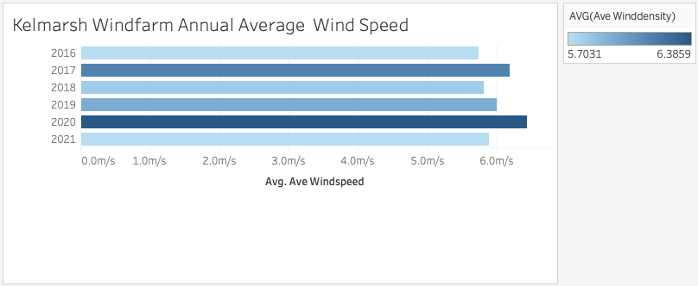
2.1 Windfarm site Annual wind speed and wind density
Energy Audit

Slide 17
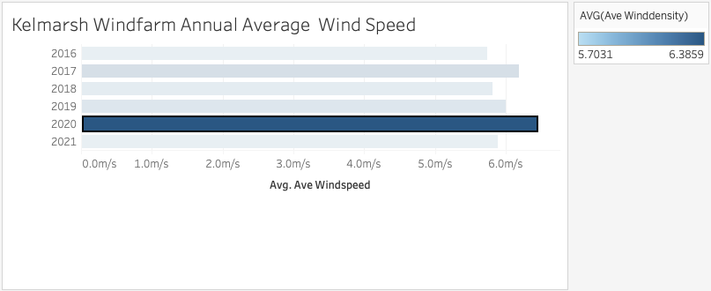
2.1 Windfarm site Annual wind speed and wind density (max)
Energy Audit

Slide 18
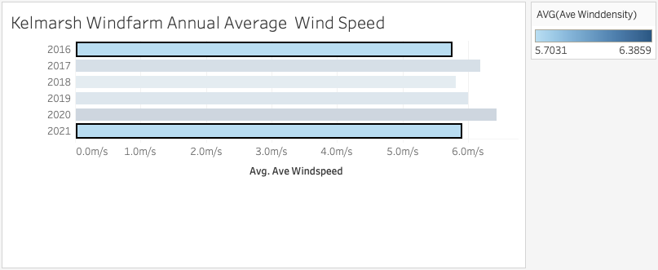
2.1 Windfarm site Annual wind speed and wind density (min)
Energy Audit

Slide 19
2.1 Windfarm site Annual wind speed and wind density
Energy Audit

Slide 20
Windfarm Site Performance
Average Wind Speed and Wind Density
(by Season)
Energy Audit

Slide 21
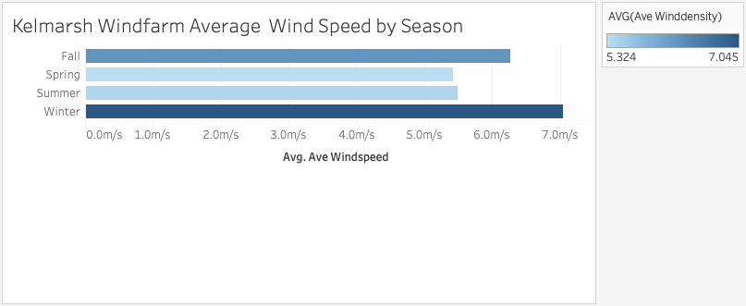
2.1 Windfarm site wind speed and wind density by Season
Energy Audit

Slide 22
2.1 Windfarm site wind speed and wind density by Season
Energy Audit

Slide 23
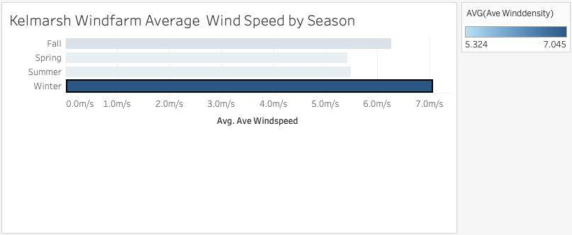
2.1 Windfarm site wind speed and wind density (max) by Season
Energy Audit

Slide 24
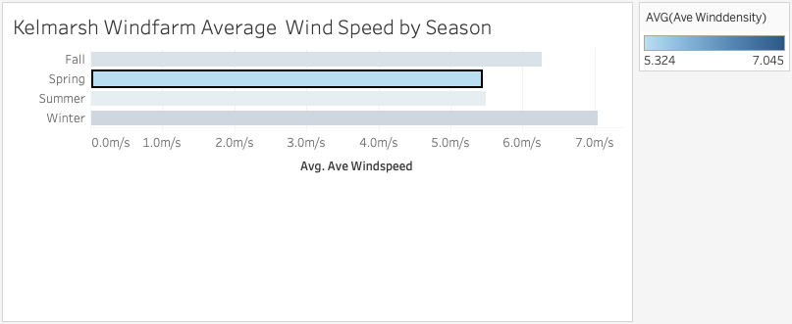
2.1 Windfarm site wind speed and wind density (min) by Season
Energy Audit

Slide 25
2.1 Windfarm site wind speed and wind density by Season
Energy Audit

Slide 26
Electricity Generation
(Total Electricity Generated)
Energy Audit

Slide 27
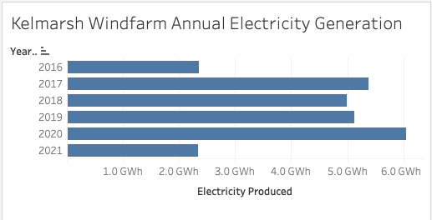
2.2 Windfarm accumulated electricity generation audit
Energy Audit

Slide 28
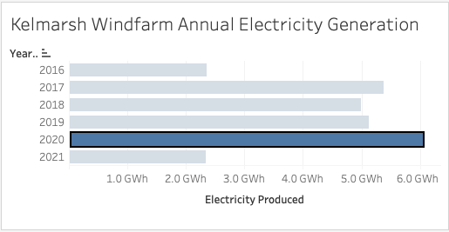
2.2 Windfarm accumulated electricity generation (max) audit
Energy Audit

Slide 29
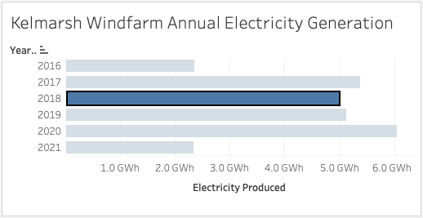
2.2 Windfarm accumulated electricity generation (min) audit
Energy Audit

Slide 30
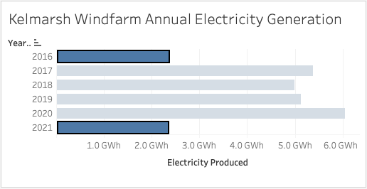
2.2 Windfarm accumulated electricity generation (incomplete) audit
Energy Audit

Slide 31
2.2 Windfarm accumulated electricity generation audit
Energy Audit

Slide 32
Electricity Generation
(Average Electricity Generated)
Energy Audit

Slide 33
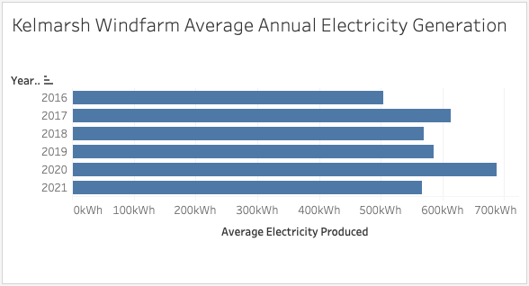
2.3 Windfarm average electricity generation audit
Energy Audit

Slide 34
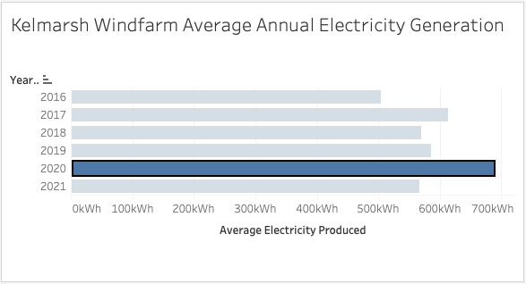
2.3 Windfarm average electricity generation (max)
Energy Audit

Slide 35
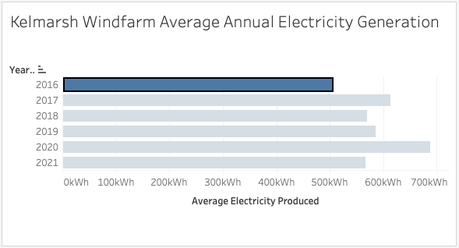
2.3 Windfarm average electricity generation (min)
Energy Audit

Slide 36
2.3 Windfarm average electricity generation audit
Energy Audit

Slide 37
Electricity Generation
Wind Speed and Wind Density Filtered
(Average Electricity Generated)
Energy Audit

Slide 38
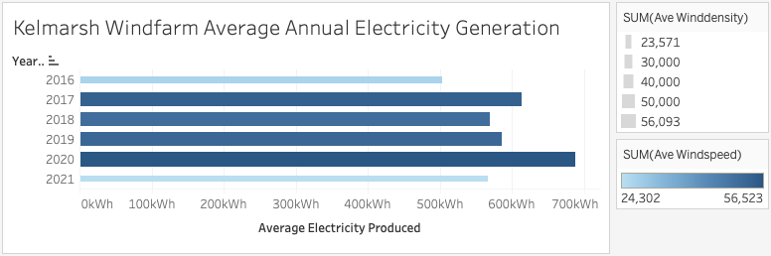
2.3 Windfarm average electricity generation audit
Energy Audit

Slide 39
2.3 Windfarm average electricity generation audit
Energy Audit

Slide 40
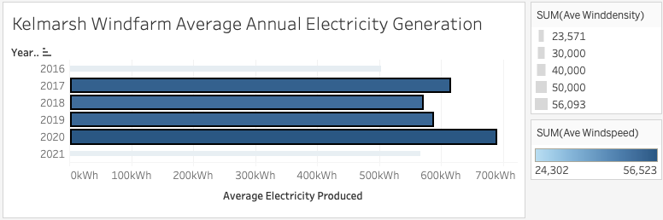
2.3 Windfarm average electricity generation(adjusted)
Energy Audit

Slide 41
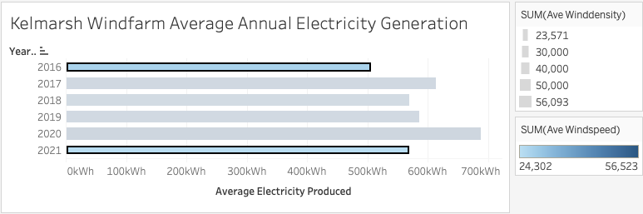
2.3 Windfarm average electricity generation audit
Energy Audit

Slide 42
2.3 Windfarm average electricity generation audit
Energy Audit

Slide 43
Electricity Generation
(Distribution of Average Electricity Generated)
Energy Audit

Slide 44
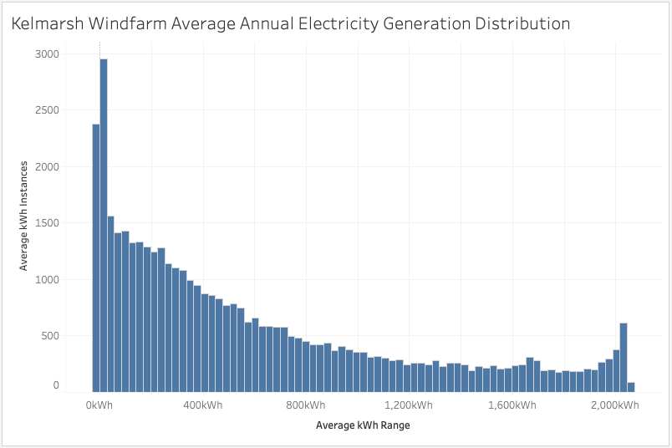
2.4 Windfarm average electricity generation (distribution)
Energy Audit

Slide 45
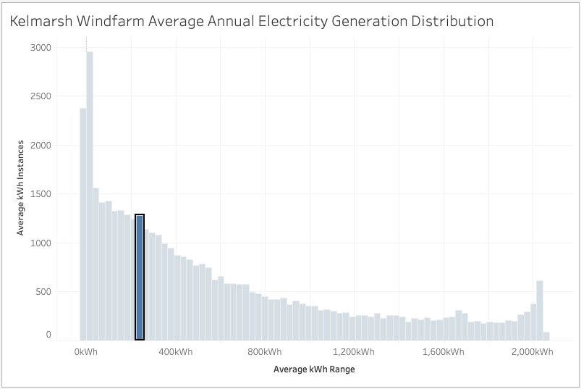
2.4 Windfarm average electricity generation (distribution)
Bin
Energy Audit

Slide 46
2.3 Windfarm average electricity generation (distribution) audit
Energy Audit

Slide 47
2.3 Windfarm average electricity generation (distribution) audit
Energy Audit

Slide 48
2.3 Windfarm average electricity generation (distribution) audit
Energy Audit

Slide 49
Electricity Generation
Wind Speed and Wind Density Filtered
(Average Distribution)
Energy Audit

Slide 50
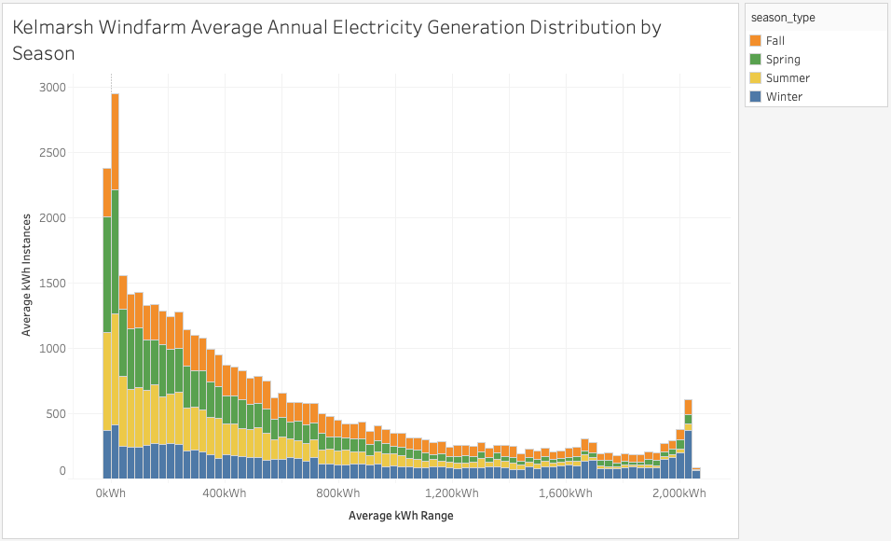
2.3 Windfarm average electricity generation (distribution) audit
Energy Audit

Slide 51
2.3 Windfarm average electricity generation (distribution) audit
Energy Audit

Slide 52
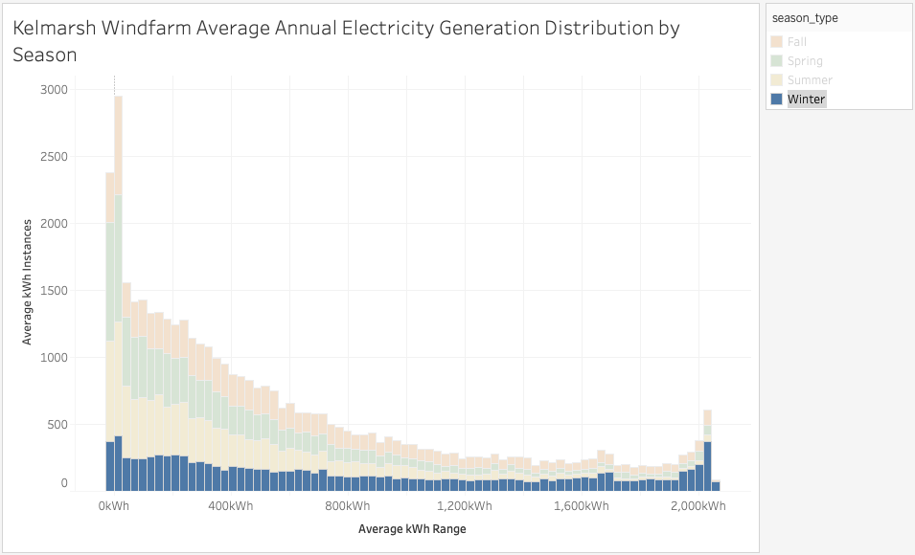
2.3 Windfarm average electricity generation (distribution) audit
Energy Audit

Slide 53
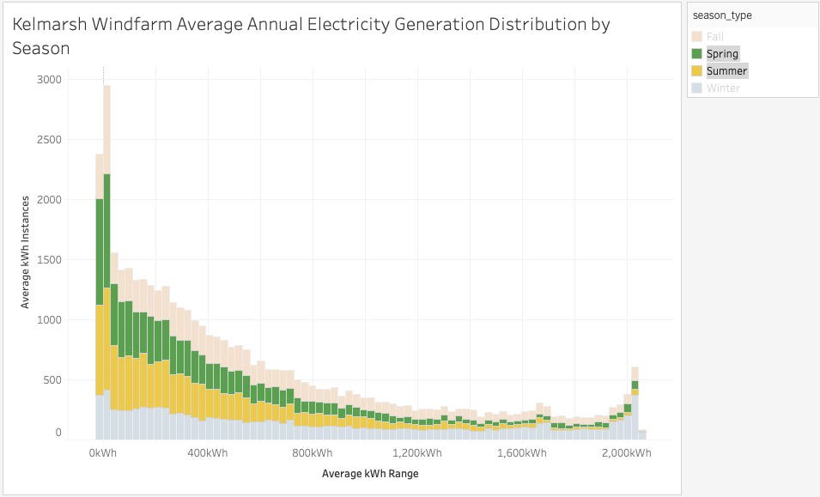
2.3 Windfarm average electricity generation (distribution) audit
Energy Audit

Slide 54
Electricity Generation
Equivalent Carbon Dioxide (eCO2)
Energy Audit

Slide 55
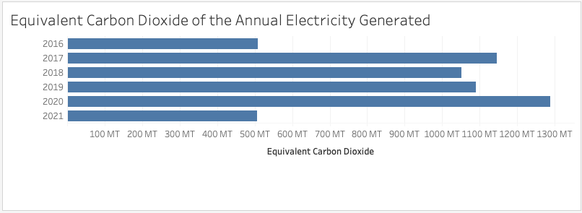
2.4 Environmental impact
Energy Audit

Slide 56
Energy Audit Results
Energy Audit

Slide 57
2.5 Energy Audit Results
Annual Electricity Generation
The typical range of annual electricity generation Kelmarsh Windfarm is between 5.0 GWh to 6.0 GWh based on the previous electricity generation from 2017 to 2020.
The electricity generation in 2016 and 2021 was affected by the absence of data caused by the time that the windfarm started operated and by the cut-off of available data, respectively.
Energy Audit

Slide 58
2.5 Energy Audit Results
Average Electricity Generation
The average electricity generation Kelmarsh Windfarm is about 600kWh based on the average electricity generation from 2016 to 2021.
The average electricity generation in 2016 and 2021 is likely affected by the absence of data caused by the time that the windfarm started operated and by the cut-off of available data, respectively.
Energy Audit

Slide 59
2.5 Energy Audit Results
Key Result
The average annual electricity generation Kelmarsh Windfarm is about 600kWh/year based on the average electricity generation from 2016 to 2021.
Kelmarsh Windfarm has a current (as of June 2021) average electricity generation of 0.6MW
Energy Audit

Slide 60
3.0 Energy Analytics
Kelmarsh Windfarm
Time Series Analysis

Slide 61
Time Series Graph
Energy Audit

Slide 62
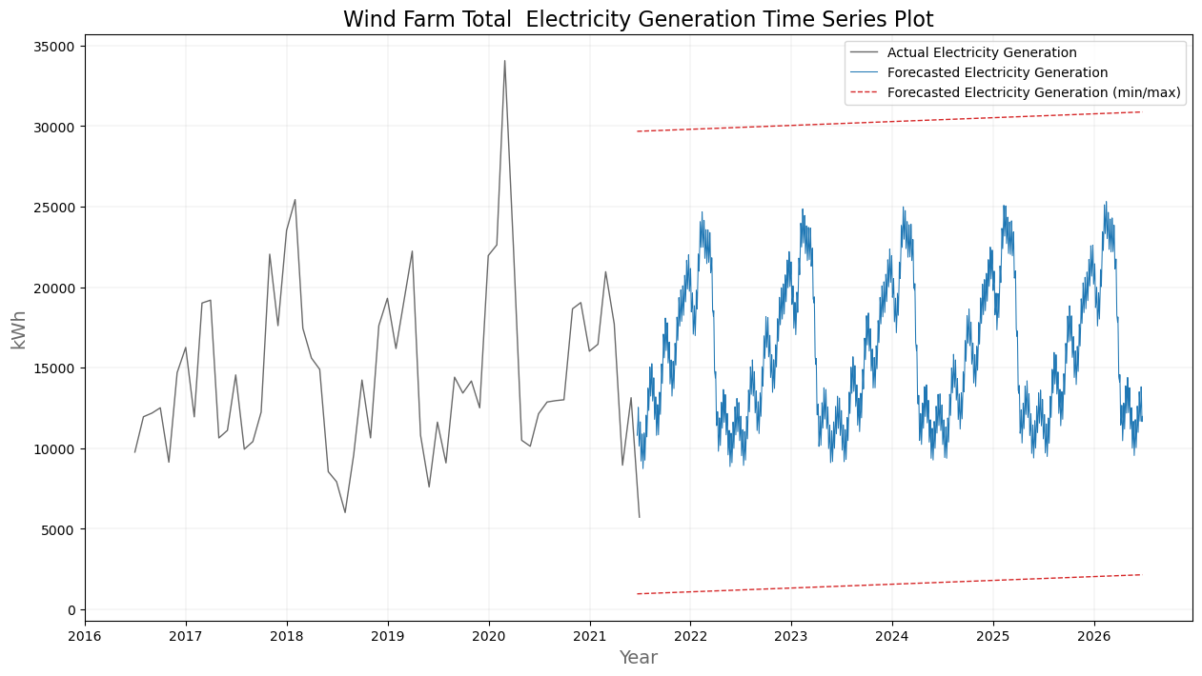
3.1 Projected windfarm performance (2021 to 2026)
Energy Analytics

Slide 63
3.1 Projected windfarm performance (2021 to 2026)
Energy Analytics

Slide 64
3.1 Projected windfarm performance (2021 to 2026)
Energy Analytics

Slide 65
Time Series Graph
(Historical Data)
Energy Audit

Slide 66
3.1 Projected windfarm performance (2021 to 2026)
Historical Data
Energy Analytics

Slide 67
3.1 Projected windfarm performance (2021 to 2026)
Energy Analytics

Slide 68
3.1 Projected windfarm performance (2021 to 2026)
Energy Analytics

Slide 69
3.1 Projected windfarm performance (2021 to 2026)
Energy Analytics

Slide 70
3.1 Projected windfarm performance (2021 to 2026)
The trend of the total electricity generated by Kelmarsh Windfarm have a regular interval of one cycle per year. Therefore, a Timeseries Analysis can be applied to forecast the future average electricity generation capacity of the windfarm based on the windfarm’s historical performance.
Energy Analytics

Slide 71
Time Series Graph
(Predicted Data)
Energy Audit

Slide 72
3.1 Projected windfarm performance (2021 to 2026)
Predicted Data
Energy Analytics

Slide 73
3.1 Projected windfarm performance (2021 to 2026)
Similar regular interval
Energy Analytics

Slide 74
3.1 Projected windfarm performance (2021 to 2026)
Maximum trend line
Energy Analytics

Slide 75
3.1 Projected windfarm performance (2021 to 2026)
Minimum trend line
Energy Analytics

Slide 76
3.1 Projected windfarm performance (2021 to 2026)
Altogether, the predicted data from the processed historical data can be used as a guide for decision making. In this example, the result of the Timeseries Analysis predicts that the electricity generation of Kelmarsh Windfarm will show some growth in the next five years(2021 to 2026).
Energy Analytics

Slide 77
3.1 Projected windfarm performance (2021 to 2026)
Historical Data
Model
Predicted Data
Energy Analytics

Slide 78
Wind Turbines
Time Series Analysis
Energy Audit

Slide 79
Time Series Graph
Energy Audit

Slide 80

3.2 Projected wind turbines performance (2021 to 2026)
Energy Analytics

Slide 81
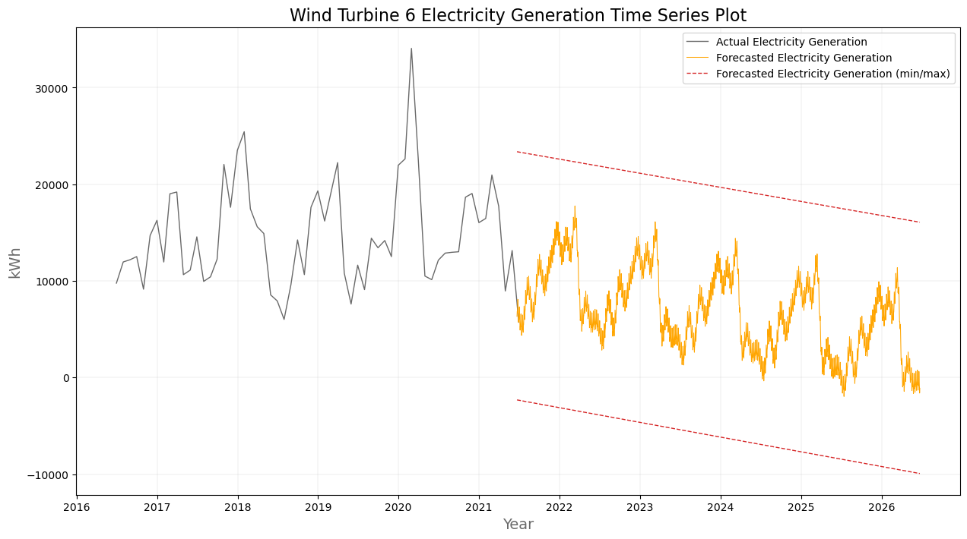
3.2 Projected wind turbines performance (2021 to 2026)
Energy Analytics

Slide 82
4.0 Key Recommendations and Future Analysis
From Energy Audit:
As a reference for future windfarm projects, a windfarm site analysis can be done to ensure that the windfarm will operate in close to its nameplate capacity.
From Energy Analytics:
Perform a detailed audit and analysis on each turbine to determine whether an intensive maintenance check-up is necessary.

